Slide 1
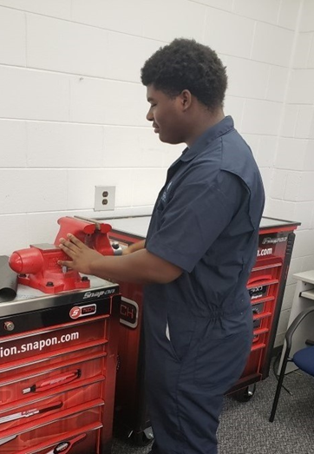
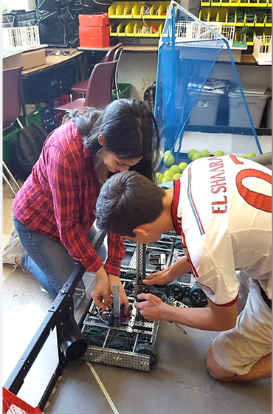
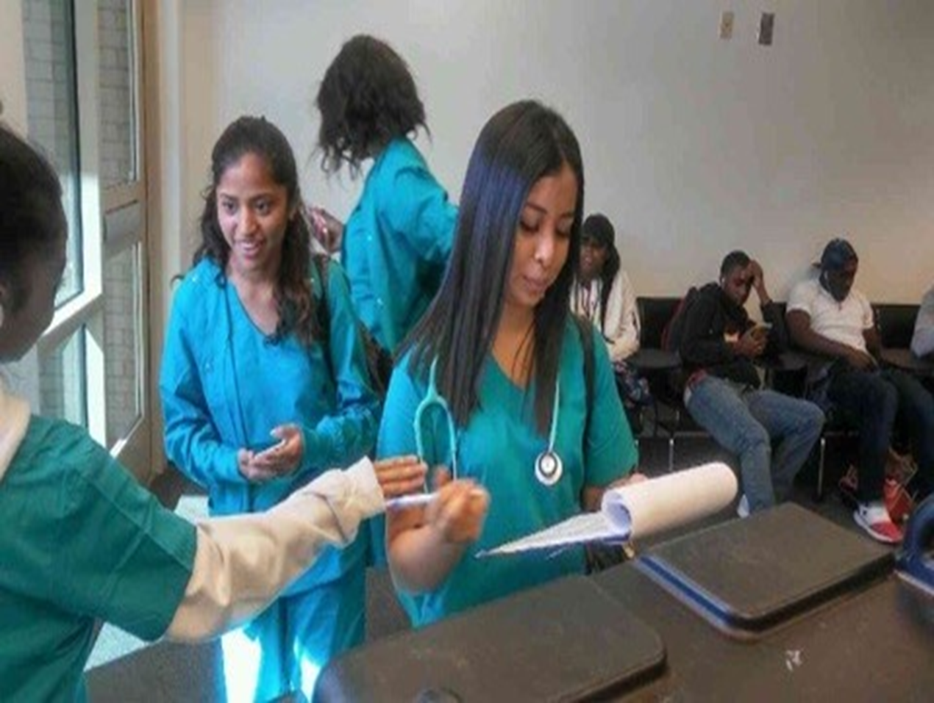
VIRTUAL OPEN HOUSE
AUGUST 20, 2020 1:00PM

Slide 2
A MESSAGE FROM: DR. TASHARAH WILSON, PRINCIPAL ACCA

Slide 3
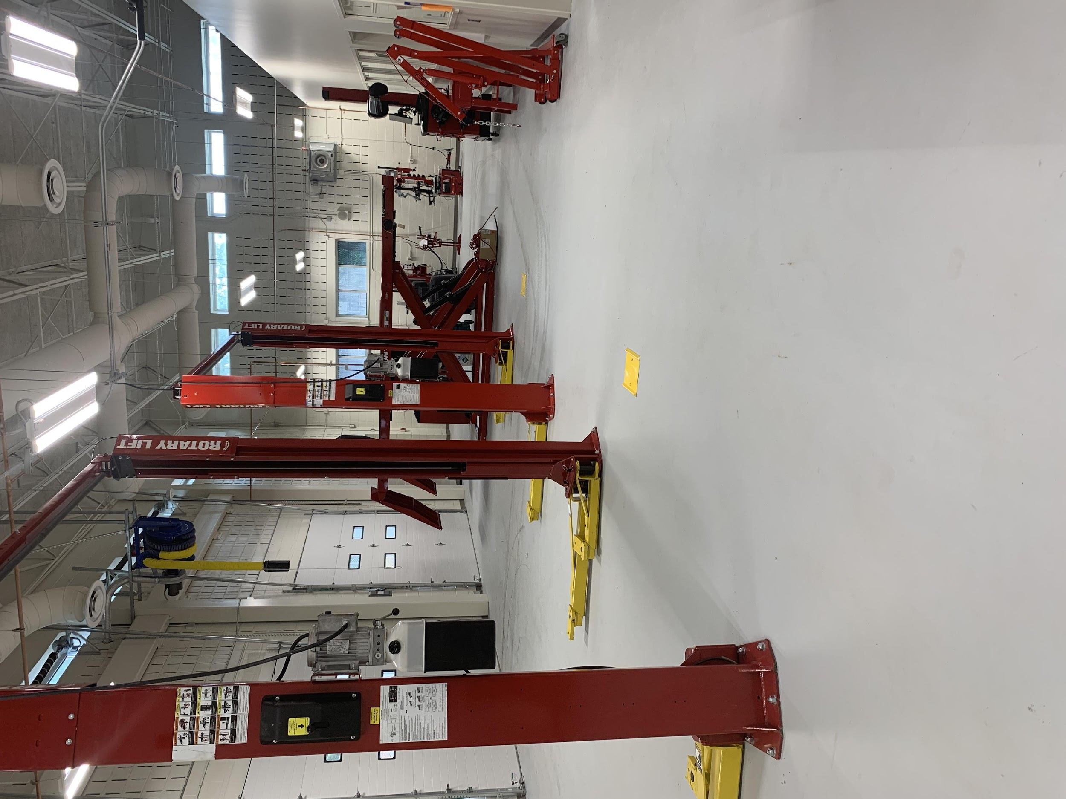
AUTOMOTIVE TECHNOLOGY PATHWAY
ANDREA STROMMEN, INSTRUCTOR
ANDREA.STROMMEN@APSK12.ORG
ASE MASTER CERTIFIED TECHNICIAN, L1, X1, G1, P2, C1 SPECIALIST CERTIFICATIONS
Notes:
Notes to presenter:
What is your purpose for sharing this reflection?
Is it at the end of a unit or project?
Are you sharing this reflection, at the attainment of a learning goal you set for yourself?
Is it at the end of a course?
State your purpose for the reflection or even the purpose of the learning experience or learning goal. Be clear and be specific in stating your purpose.

Slide 4
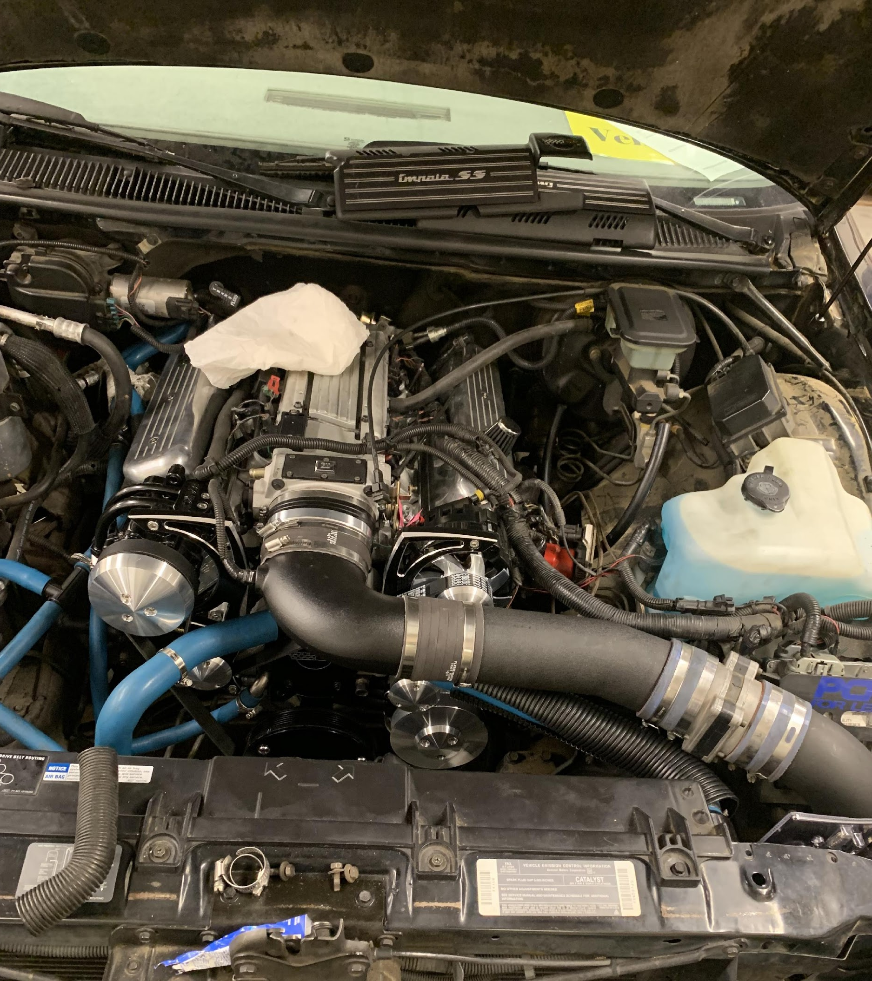
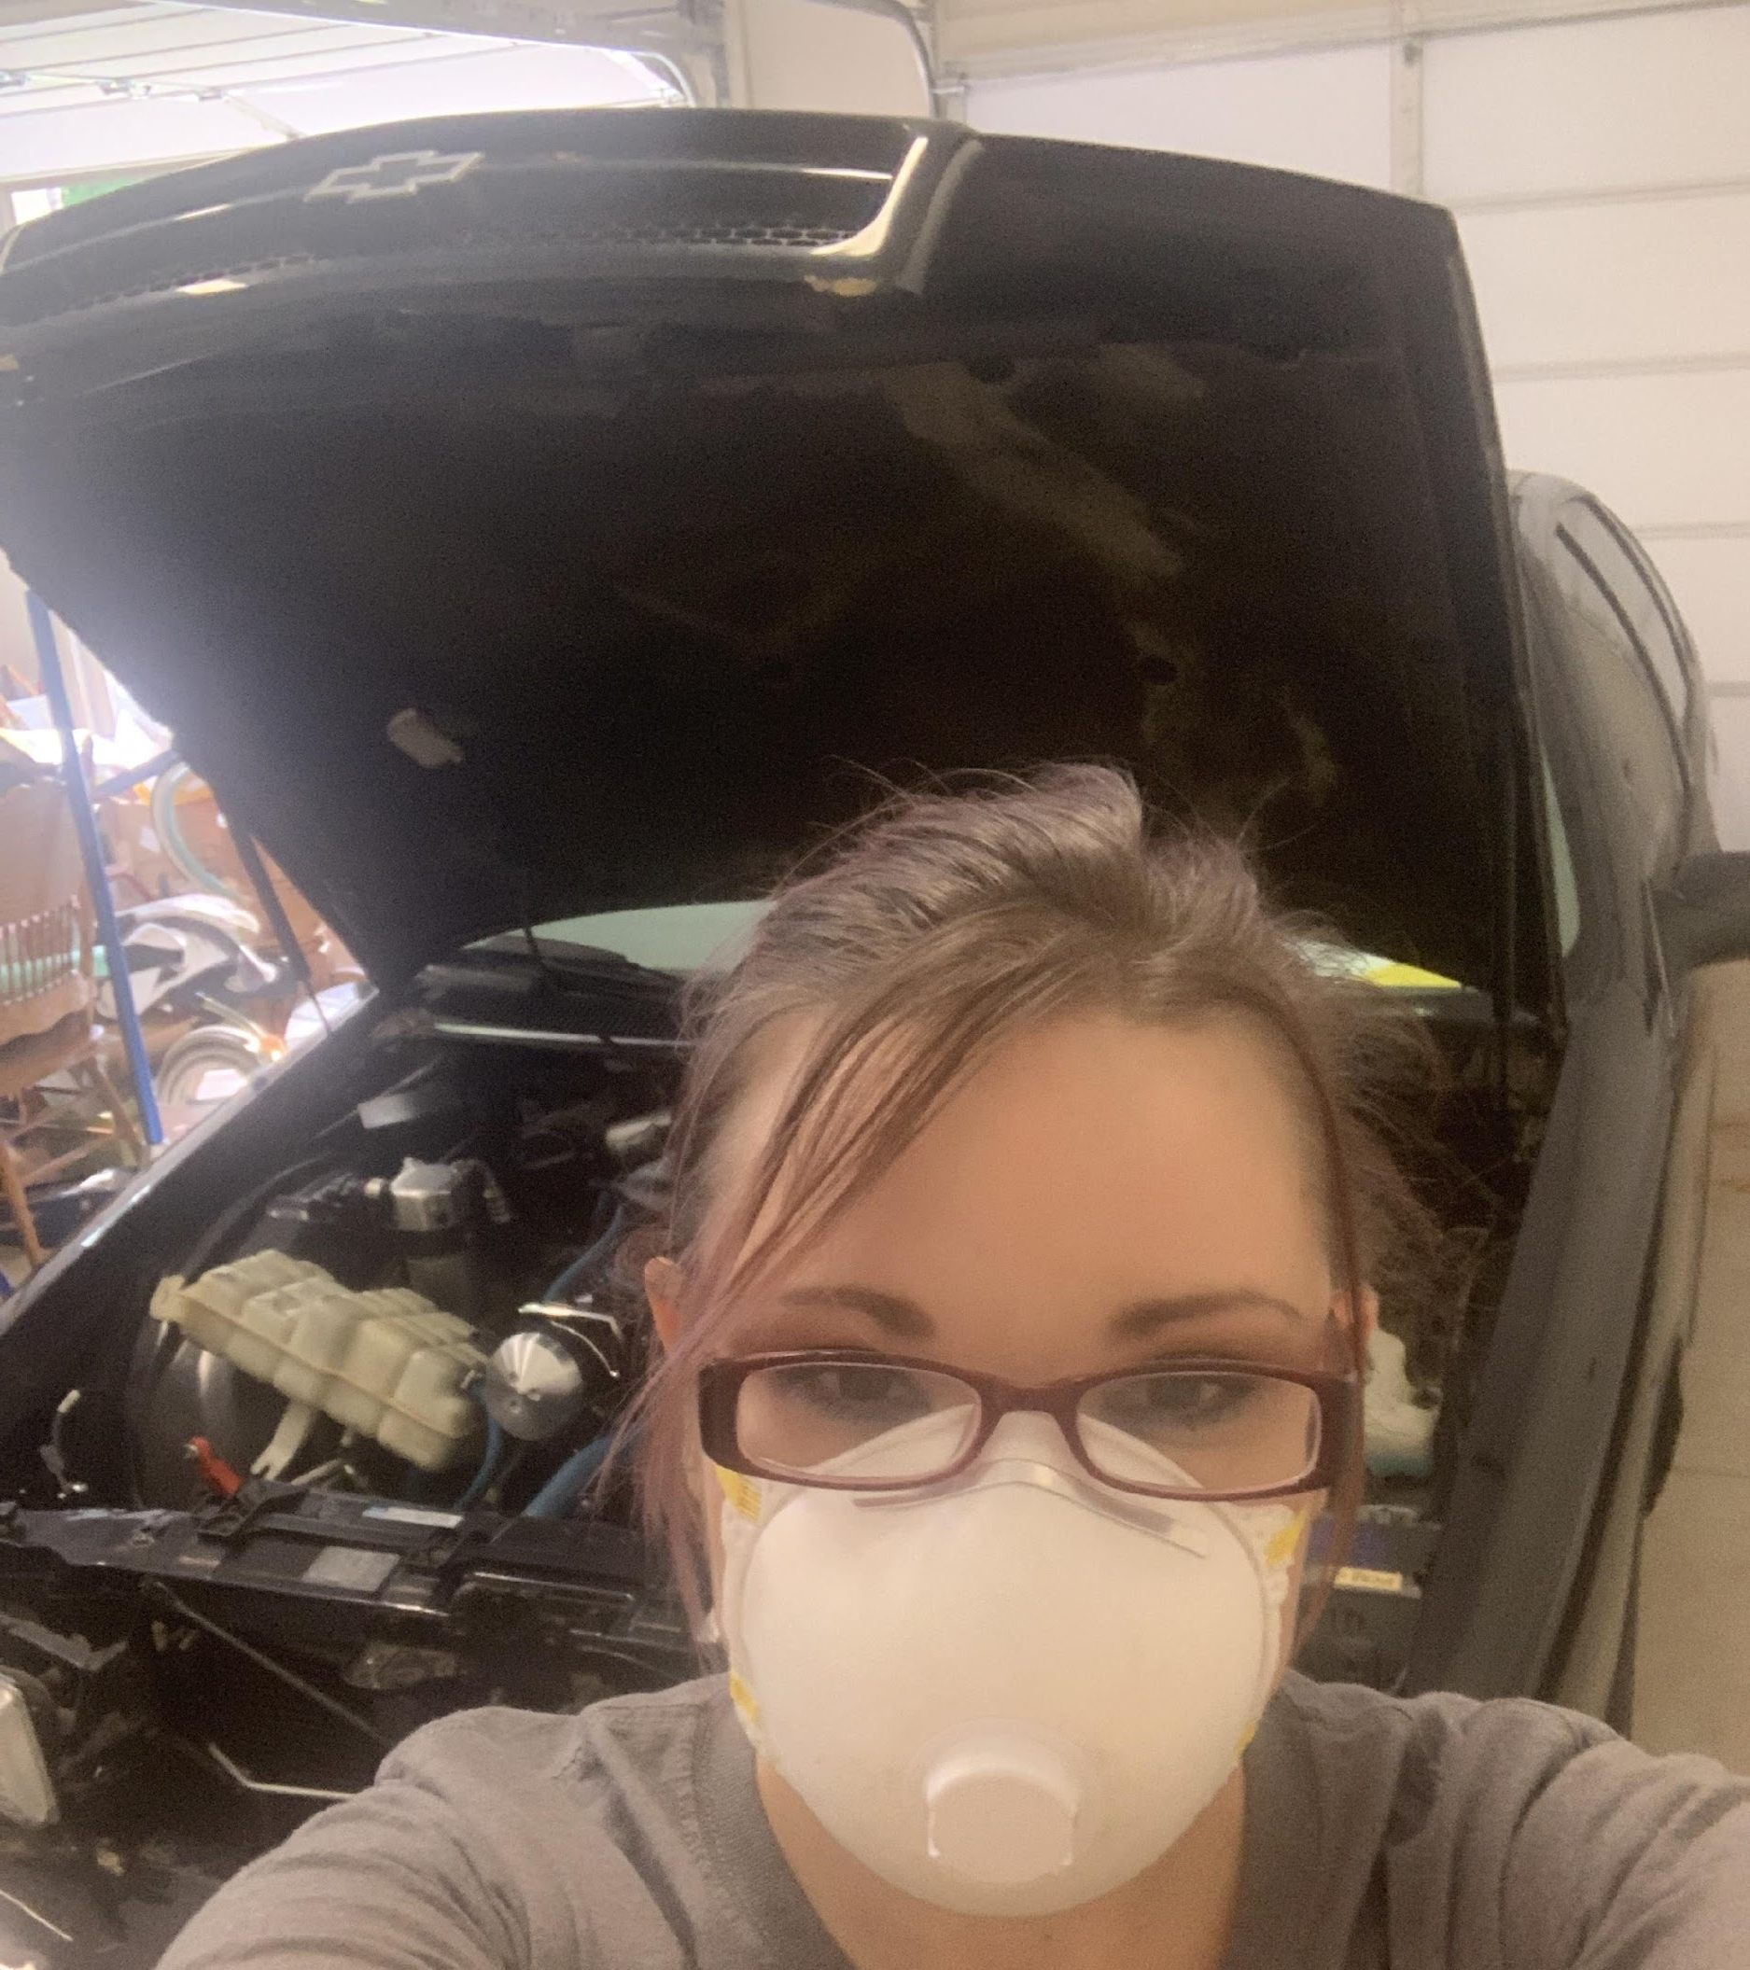
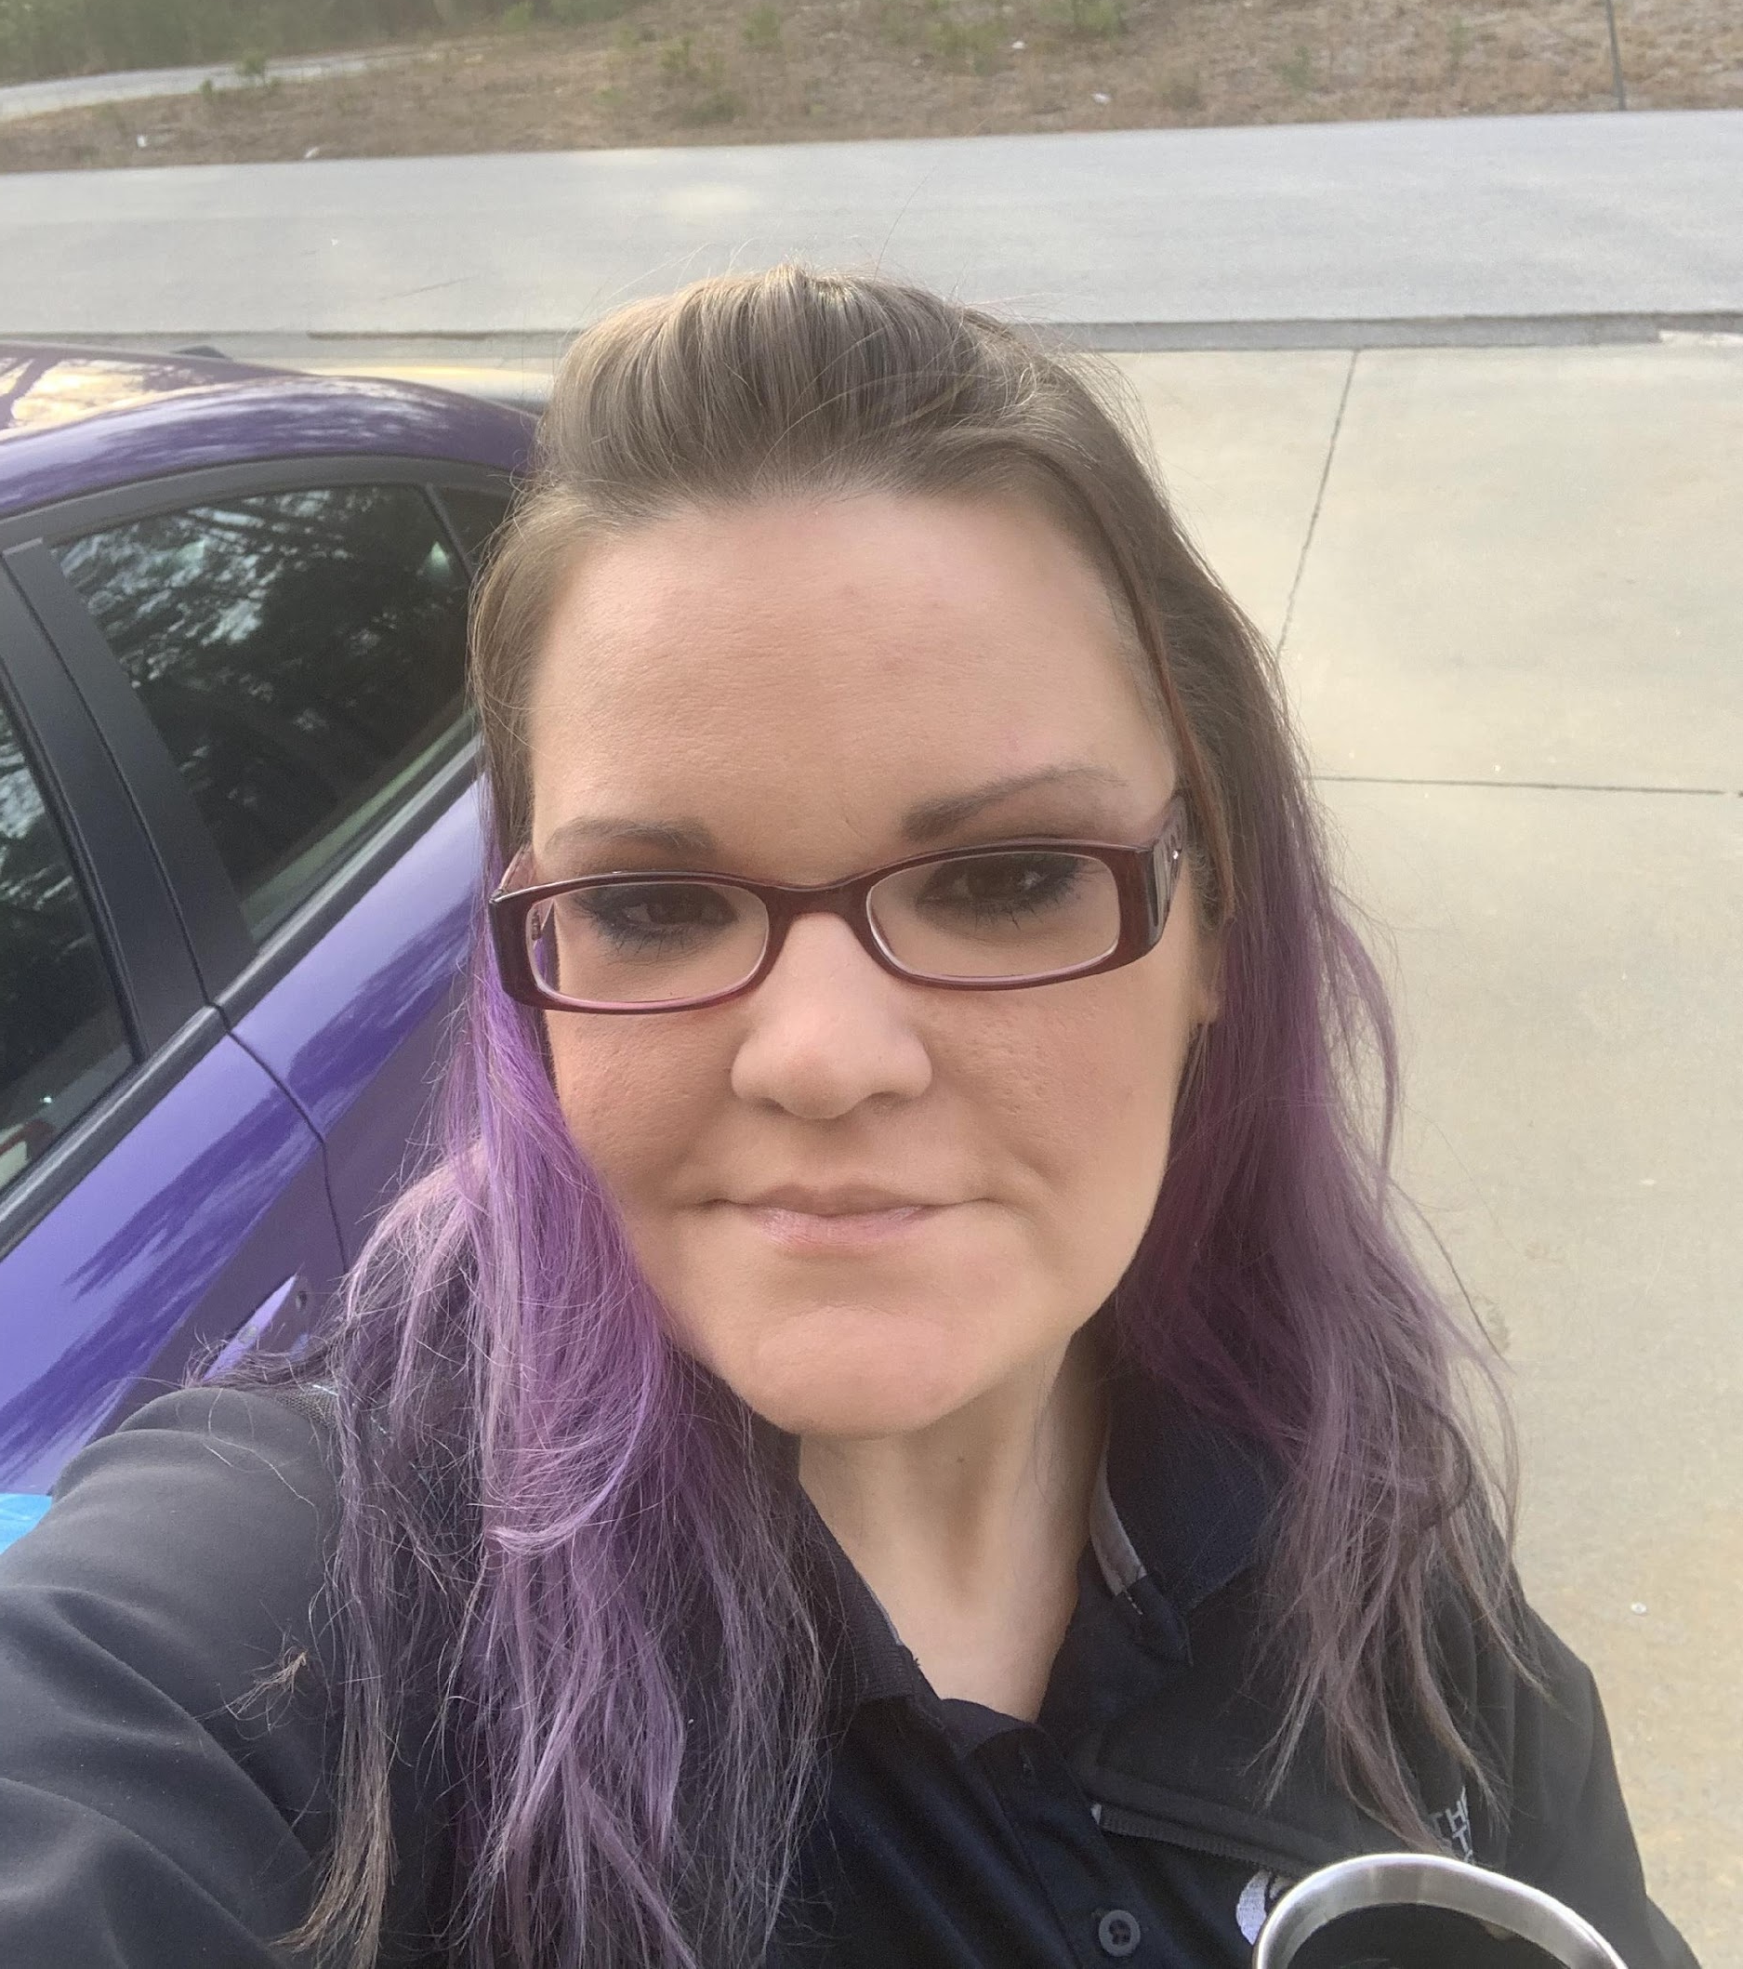
I’M EXCITED TO MEET YOU AND BE YOUR TEACHER!!!
I am from Central Wisconsin, lived in Atlanta now for 20 years.
Over 15 Years experience in the Automotive Industry
An advocate for non-traditional students in CTAE
Automotive Technology AAS, Chattahoochee Technical College
GA Vocational High School Education Cert. from Georgia State Uni.
Education and Leadership studies, B.S. , Kennesaw State University
Currently: finishing my Masters of Ed. in Adult and Career Education at Valdosta State University
Enjoy customizing American muscle cars and trucks from low-riders to lifted 4x4’s, building high-performance engines & drivetrains, and pro-touring upgrades.

Slide 5
THE SCHEDULE & HOW IT WORKS

Slide 6
A MESSAGE FROM: DR. SHAUNDRA FEARS

Slide 7
STUDENT RESOURCES & COUNSELORS

Slide 8
A MESSAGE FROM: COUNSELORS

Slide 9
AUTOMOTIVE PROGRAM DETAILS

Slide 10
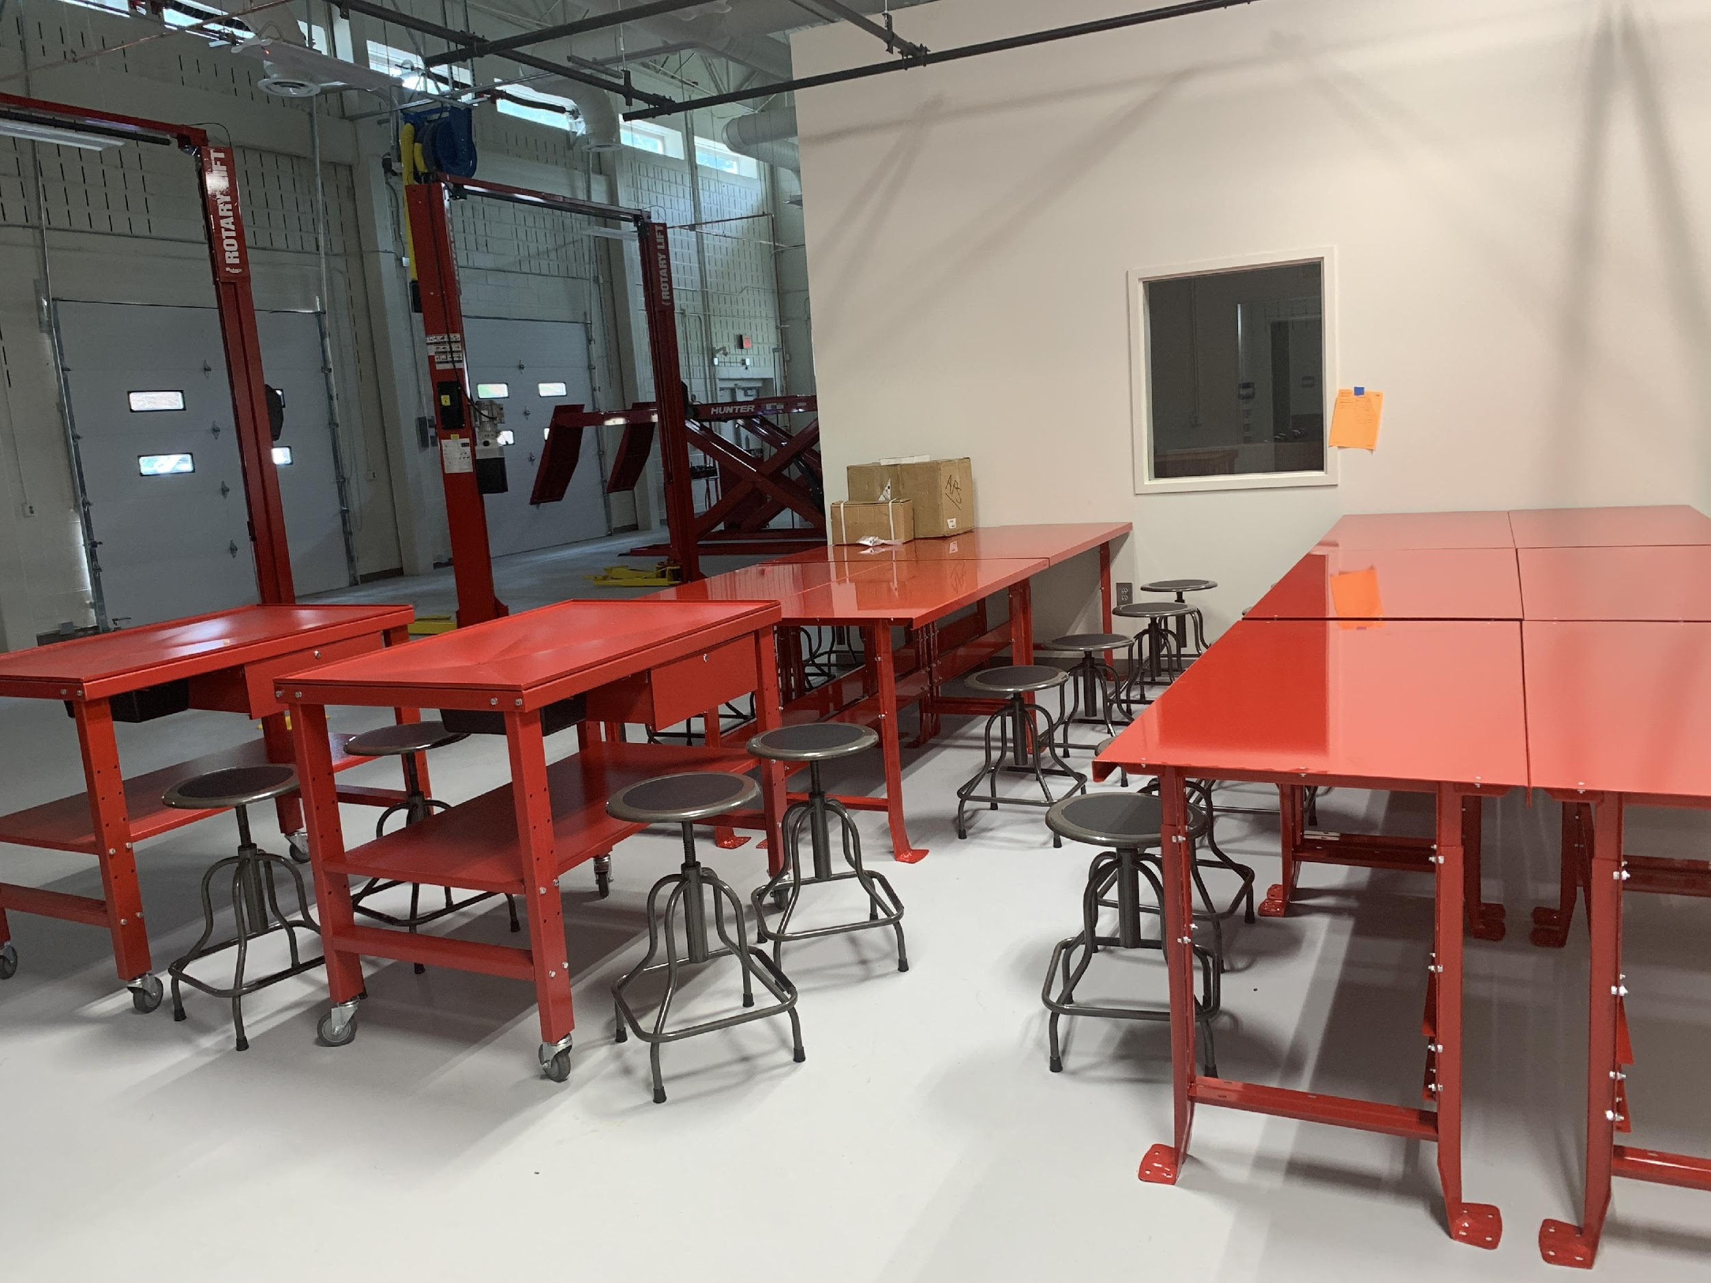
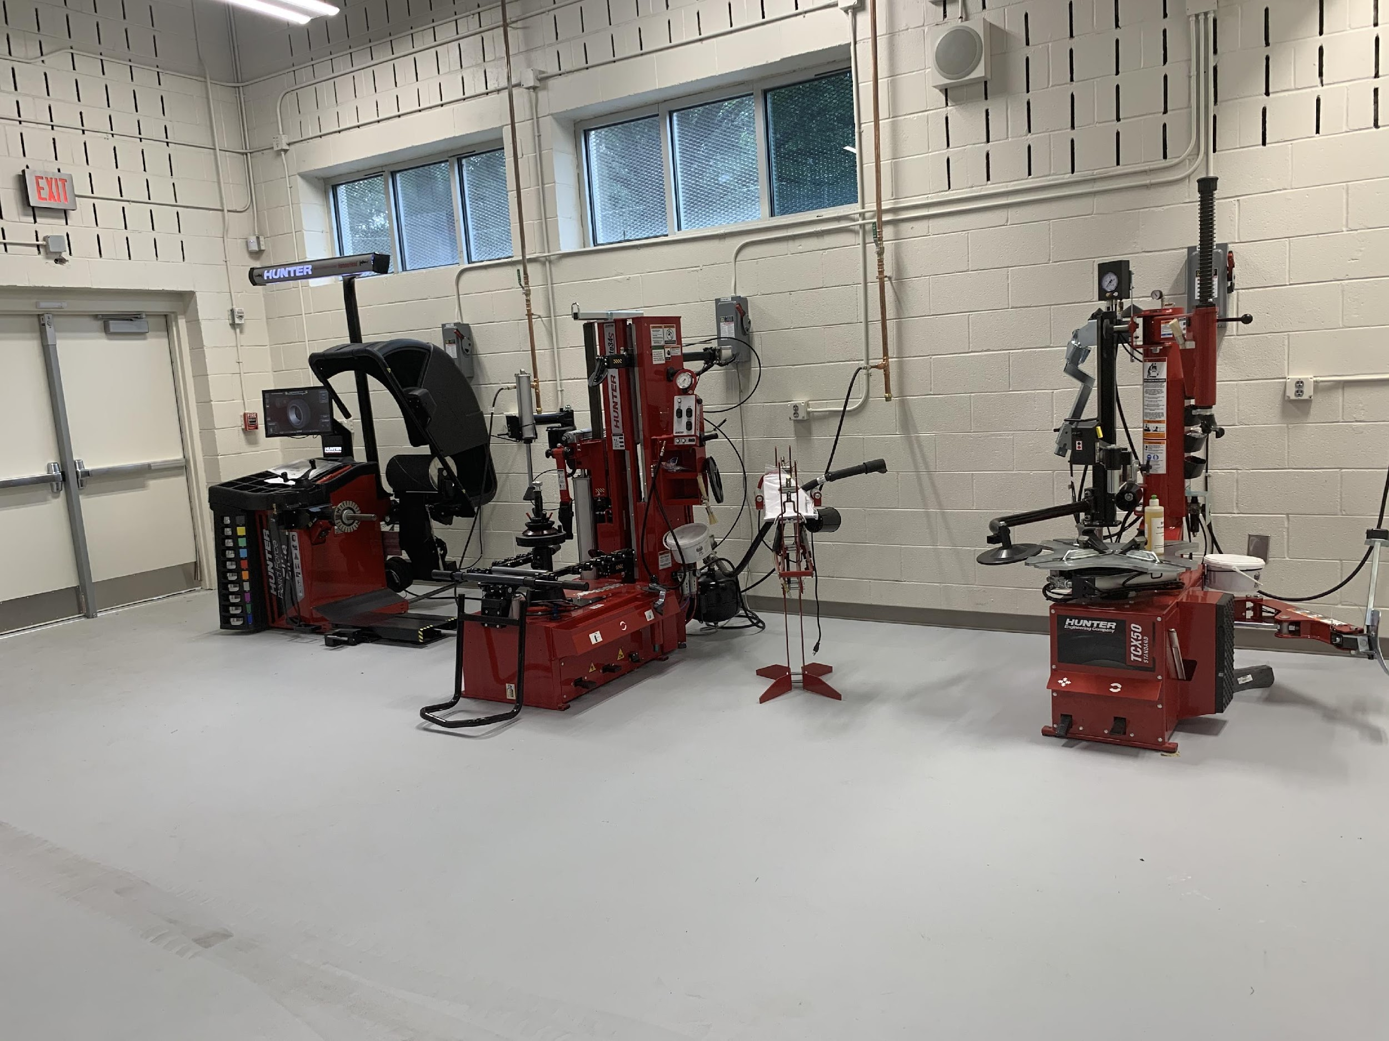
WHAT TO EXPECT:
CTAE program tailored to raising the bar and bring industry career training opportunities into the classroom.
Individualized Learning Plans to build strengths for successful entry placement in the automotive industry
Real-World Style Labs and Instruction
Hands-On Approaches to learning with state-of-the-art online Engine Management Simulators and lessons for Virtual Instruction
Automotive Equipment & SafetyTraining
Snap-On Education tool certification opportunities in Electrical testing and Digital Multimeters.
Guest speakers from Metro Atlanta dealerships, shops, and industry partners
Notes:
Notes to presenter:
Description of what you learned in your own words on one side.
Include information about the topic
Details about the topic will also be helpful here.
Tell the story of your learning experience. Just like a story there should always be a beginning, middle and an end.
On the other side, you can add a graphic that provides evidence of what you learned.
Feel free to use more than one slide to reflect upon your process. It also helps to add some video of your process.

Slide 11
AUTOMOTIVE TRAINING & INSTRUCTIONAL RESOURCES
Automotive Training & Learning Simulators:
Electude
Workplace Safety & Lift Training
SP2.org & CCAR Safety
Google Classroom & Zoom Meetings
Shop Lab featuring:
Hunter Engineering Equipment
Tools and Partnerships from Nationally recognized vendors including:
SnapOn Tools &
Napa Auto Parts
Notes:
Notes to presenter:
Description of what you learned in your own words on one side.
Include information about the topic
Details about the topic will also be helpful here.
Tell the story of your learning experience. Just like a story there should always be a beginning, middle and an end.
On the other side, you can add a graphic that provides evidence of what you learned.
Feel free to use more than one slide to reflect upon your process. It also helps to add some video of your process.

Slide 12
GOOGLE CLASSROOM CODES:
LET’S SIGN IN:
classroom.google.com
AM Block:
3bwq2ig
First Day: August 24th 8:30AM
PM Block
wscyuhr
First Day: August 24th 12:10PM
12

Slide 13
VIDEO
LET’S SIGN IN
WHAT IS ELECTUDE?
A comprehensive curriculum of Automotive Maintenance and Light Repair through discovery-based e-learning,
Aligned with Georgia’s Standards in Automotive Service Technology Programs
https://gaacca.electude.com/slogin
13

Slide 14
ELECTUDE: ENGINE MANAGEMENT SIMULATOR
Click image for demo video

Slide 15
BEYOND THE CLASSROOM:
Learn areas of the field from the experts, featuring guest speakers from local shops, dealerships and industry partners.
Future Possibilities with industry partners for apprenticeships and entry-level job placement.
Skill USA member events & competition opportunities
Learn skills for life
Employability opportunities as an ACCA graduate and pathway completer
Job & Career Fairs
Automotive Events: Car & Bike Shows
Dealership Connections, Open Houses & Shop Tours
Notes:
Notes to presenter:
Description of what you learned in your own words on one side.
Include information about the topic
Details about the topic will also be helpful here.
Tell the story of your learning experience. Just like a story there should always be a beginning, middle and an end.
On the other side, you can add a graphic that provides evidence of what you learned.
Feel free to use more than one slide to reflect upon your process. It also helps to add some video of your process.

Slide 16
Any Questions?
Andrea.Strommen@apsk12.org
16

Slide 17
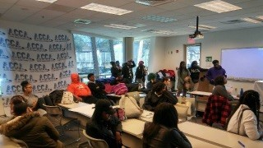
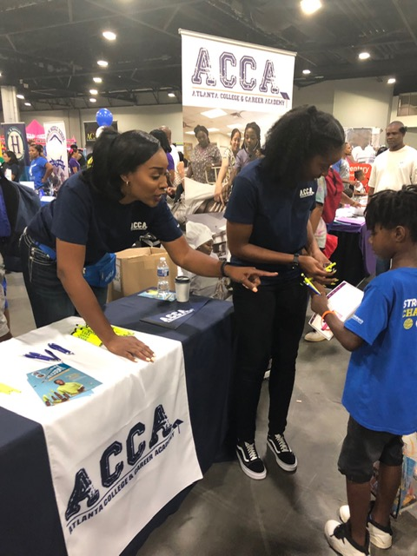
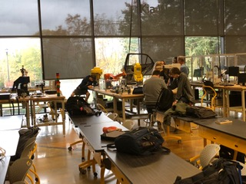
THANK YOU FOR ALL THAT YOU DO!
17

